Slide 1
Graphs

Slide 2
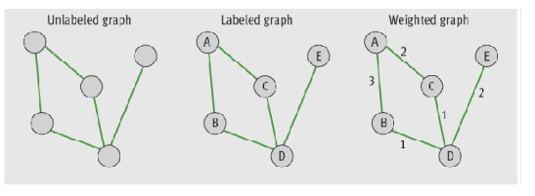
Introduction
Mathematically, a graph is a set V of vertices and a set E of edges, such that each edge in E connects two of the vertices in V
We use node as a synonym for vertex

Slide 3
Terminology
One vertex is adjacent to another vertex if there is an edge connecting the two vertices (neighbors)
Path: Sequence of edges that allows one vertex to be reached from another vertex in a graph
Length of a path: Number of edges on the path
Degree of a vertex: Number of edges connected to it

Slide 4
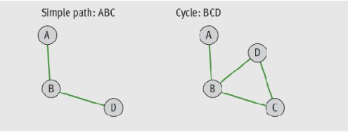
Terminology
Simple path: Path that does not pass through the same vertex more than once
Cycle: Path that begins and ends at the same vertex

Slide 5
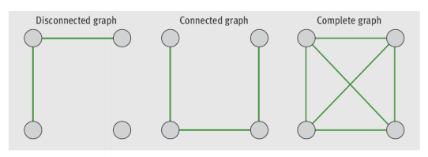
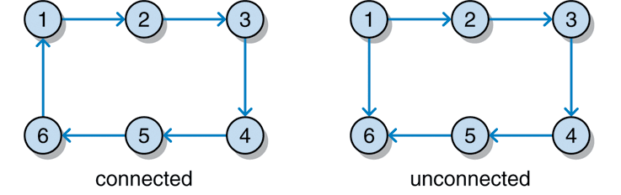
Terminology
A graph is connected if there is a path from each vertex to every other vertex
A graph is complete if there is an edge from each vertex to every other vertex

Slide 6
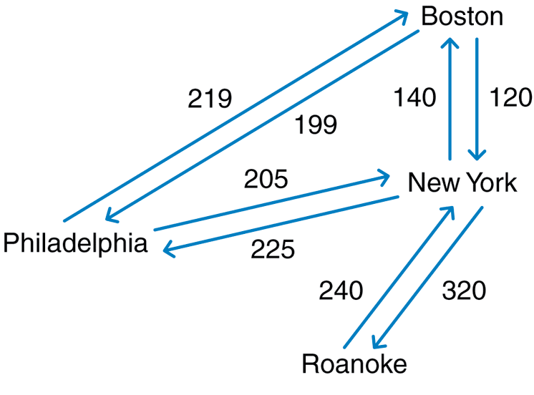
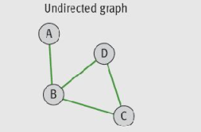
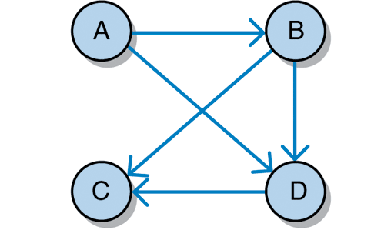
Graph Terminology
Graphs can be undirected or directed (digraph)
A directed edge has a source vertex and a destination vertex
Edges emanating from a given source vertex are called its incident edges
To convert undirected graph to equivalent directed graph, replace each edge in undirected graph with a pair of edges pointing in opposite directions

Slide 7
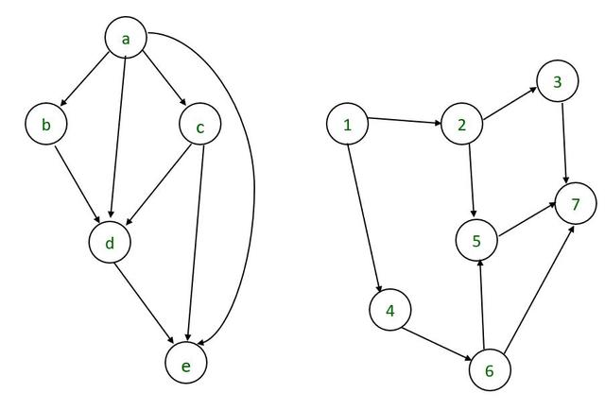
Terminology
A special case of digraph that contains no cycles is known as a directed acyclic graph, or DAG

Slide 8
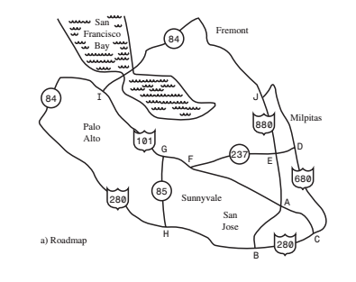
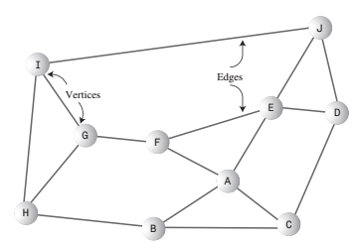
Graph Applications – Example - Roadmap

Slide 9
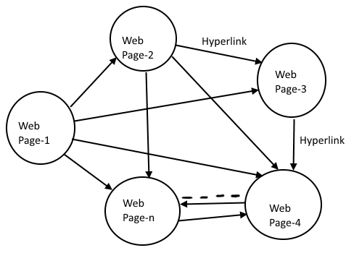
Graph Applications – Example – Web Links

Slide 10
Graph Applications
Graphs serve as models of a wide range of objects:
A roadmap
A map of airline routes
A schematic of the computers and connections that make up the Internet
The links between pages on the Web
The relationship between students and courses i.e courses and their pre-requisites
A diagram of the flow capacities in a communications or transportation network

Slide 11
Representing Graphs
To represent graphs, you need a convenient way to store the vertices and the edges that connect them
Two commonly used representations of graphs:
The adjacency matrix
The adjacency list

Slide 12
Adjacency Matrix
If a graph has N vertices labeled 0, 1, . . . , N – 1:
The adjacency matrix for the graph is a grid G with N rows and N columns
Cell G[i][ j] = 1 (or F) if there’s an edge from vertex i to j
Otherwise, there is no edge and that cell contains 0

Slide 13
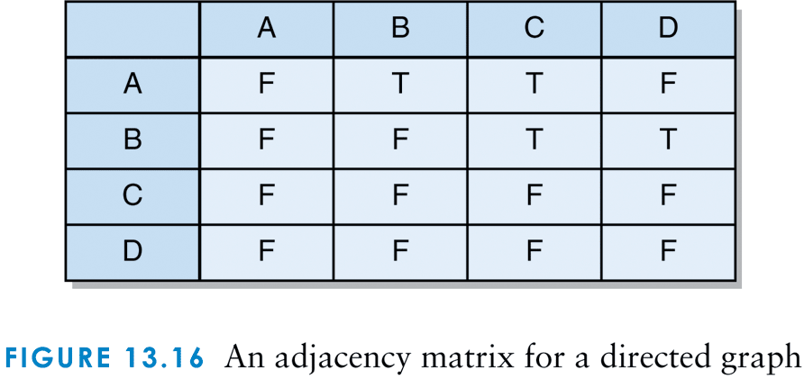
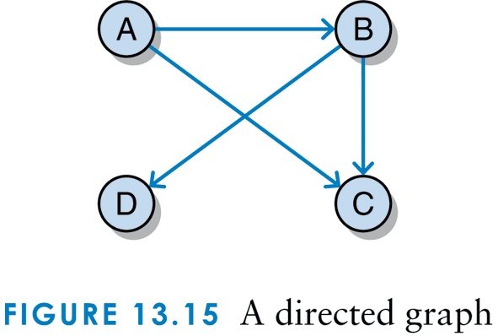
Adjacency Matrix – A Directed Graph
Cell G[i][ j] = T if there’s an edge from vertex i to j
Cell G[i][ j] = F if there’s no edge from vertex i to j

Slide 14
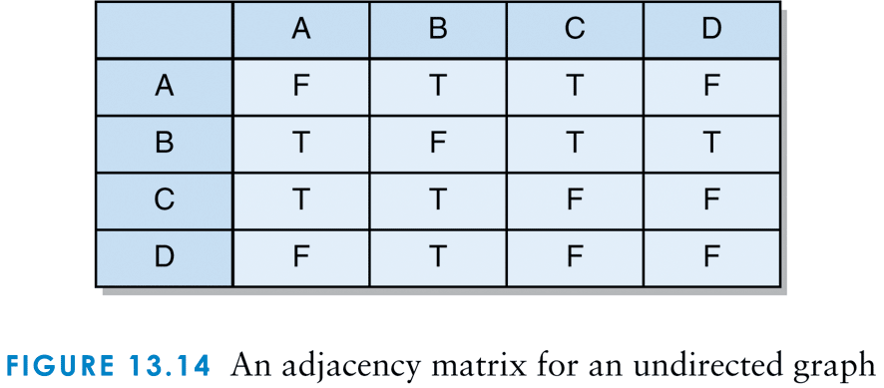
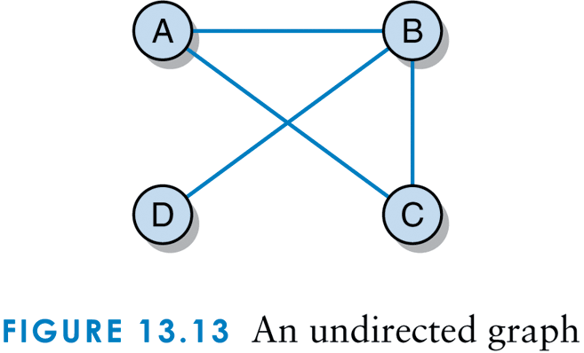
Adjacency Matrix - An Undirected Graph
Cell G[i][ j] = T if there’s an edge from vertex i to j
Cell G[i][ j] = F if there’s no edge from vertex i to j

Slide 15
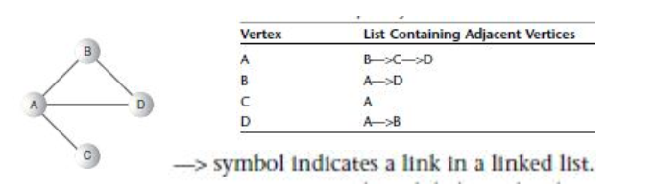
Adjacency List
If a graph has N vertices labeled 0, 1, . . . , N – 1,
The adjacency list for the graph is an array of N linked lists
Each individual list shows what vertices a given vertex is adjacent to.
Adjacency list shows which vertices are adjacent to—that is, one edge away from—a given vertex, not paths from vertex to vertex.

Slide 16
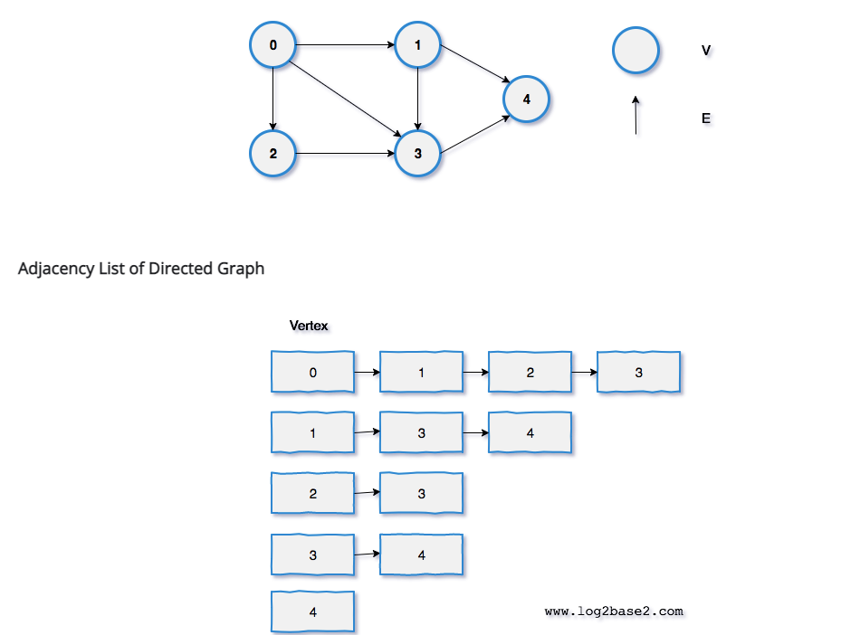
Adjacency List – Directed Graph

Slide 17
Graph Traversals
In addition to the insertion and removal of items, important graph-processing operations include: – Traversing all of the items in a graph
One starts at a given vertex and, from there, visits all vertices to which it connects
Different from tree traversals, which always visit all of the nodes in a given tree
There are two algorithms (breadth first traversal/search and depth first search/algorithm)
Finding the shortest path to a given item in a graph

Slide 18
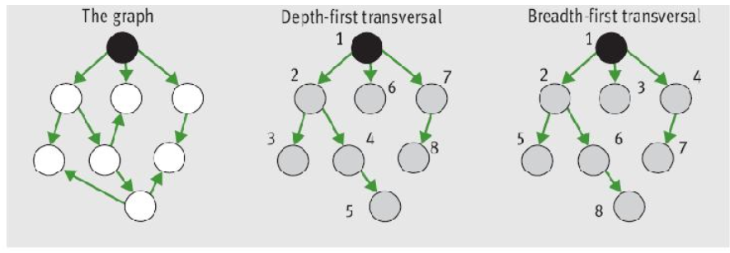
Graph Traversal
A depth-first search (DFS), uses a stack
A breadth-first search (BFS), uses a queue

Slide 19
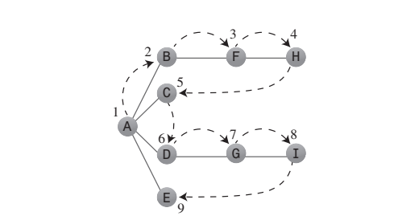
Depth First Search

Slide 20
Depth First Search
To carry out the depth-first search, you pick a starting point—in this case, vertex A.
You then do three things: visit this vertex, push it onto a stack so you can remember it, and mark it so you won’t visit it again.
Next, you go to any vertex adjacent to A that hasn’t yet been visited. We’ll assume the vertices are selected in alphabetical order, so that brings up B. You visit B, mark it, and push it on the stack.
Now what? You’re at B, and you do the same thing as before: go to an adjacent vertex that hasn’t been visited. This leads you to F. We can call this process Rule 1.

Slide 21
Depth First Search
RULE 1: If possible, visit an adjacent unvisited vertex, mark it, and push it on the stack.
Applying Rule 1 again leads you to H. At this point, however, you need to do something else because there are no unvisited vertices adjacent to H. Here’s where Rule 2 comes in.
RULE 2: If you can’t follow Rule 1, then, if possible, pop a vertex off the stack.

Slide 22
Depth First Search
Following this rule, you pop H off the stack, which brings you back to F. F has no unvisited adjacent vertices, so you pop it. Ditto B. Now only A is left on the stack.
A, however, does have unvisited adjacent vertices, so you visit the next one, C. But C is the end of the line again, so you pop it and you’re back to A. You visit D, G, and I, and then pop them all when you reach the dead end at I. Now you’re back to A. You visit E, and again you’re back to A.
This time, however, A has no unvisited neighbors, so we pop it off the stack. But now there’s nothing left to pop, which brings up Rule 3.
RULE 3: If you can’t follow Rule 1 or Rule 2, you’re done

Slide 23
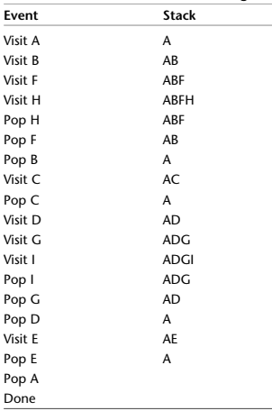
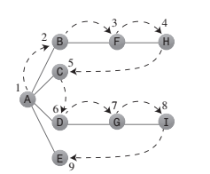
Depth Fist Search

Slide 24
DFS Algorithm
void DFS(Node startNode)
{
for v in Nodes do
v.visited = false;
Stack s = new Stack;
s.push(startNode);
while (!s.empty())
{
x = s.pop();
x.visited = true;
/* process x */
for y in x.children() do
if (!y.visited)
s.push(y);
}
}

Slide 25
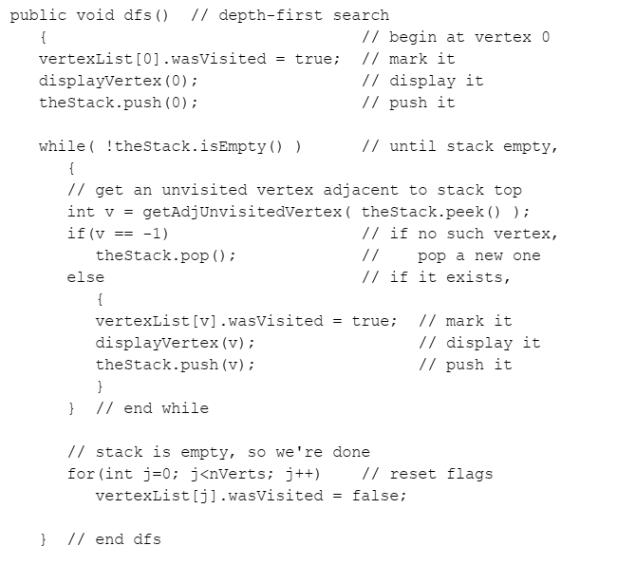
DFS Java Code

Slide 26
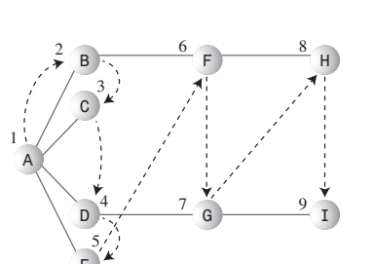
Breadth First Search
In the breadth-first search, on the other hand, the algorithm likes to stay as close as possible to the starting point.
It visits all the vertices adjacent to the starting vertex, and only then goes further afield. This kind of search is implemented using a queue instead of a stack.

Slide 27
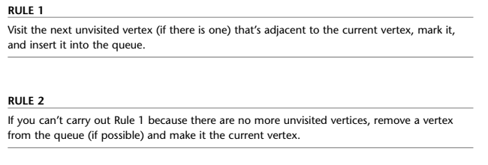

BFS

Slide 28
Breadth First Search
Thus, you first visit all the vertices adjacent to A, inserting each one into the queue as you visit it. Now you’ve visited A, B, C, D, and E. At this point the queue (from front to rear) contains BCDE.
There are no more unvisited vertices adjacent to A, so you remove B from the queue and look for vertices adjacent to it. You find F, so you insert it in the queue. There are no more unvisited vertices adjacent to B, so you remove C from the queue. It has no adjacent unvisited vertices, so you remove D and visit G. D has no more adjacent unvisited vertices, so you remove E. Now the queue is FG. You remove F and visit H, and then you remove G and visit I.
Now the queue is HI, but when you’ve removed each of these and found no adjacent unvisited vertices, the queue is empty, so you’re done. Table below shows this sequence.

Slide 29
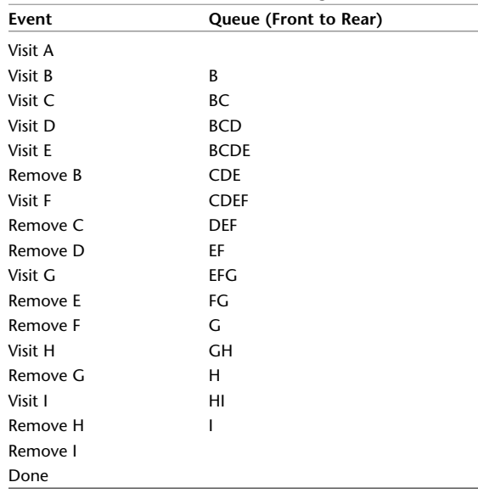
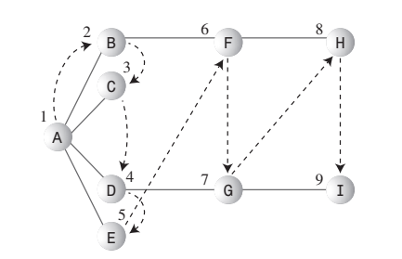
Breadth First Search

Slide 30
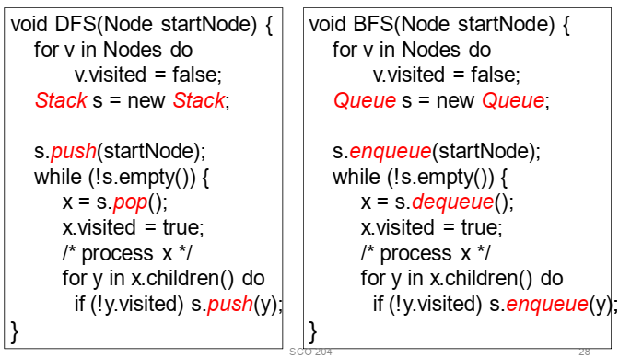
Comparison of BFS and DFS Algorithms

Slide 31
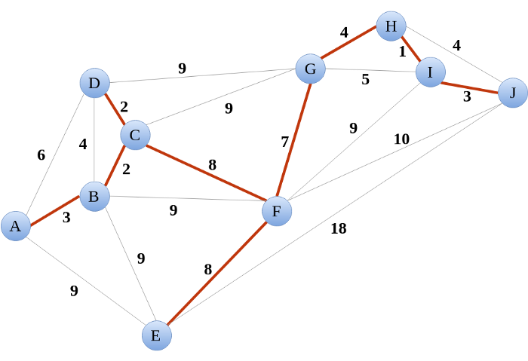
Minimum Spanning Tree
In a weighted graph, you can sum the weights for all edges in a spanning tree and attempt to find a spanning tree that minimizes this sum
There are several algorithms for finding a minimum spanning tree for a component.
For example, to determine how an airline can service all cities, while minimizing the total length of the routes it needs to support

Slide 32
Topological Sort
A directed acyclic graph (DAG) has an order among the vertices
A topological order assigns a rank to each vertex such that the edges go from lower- to higher- ranked vertices
Topological sort: process of finding and returning a topological order of vertices in a graph

Slide 33
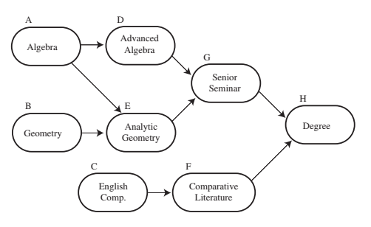
Example: Course Pre-requisites

Slide 34
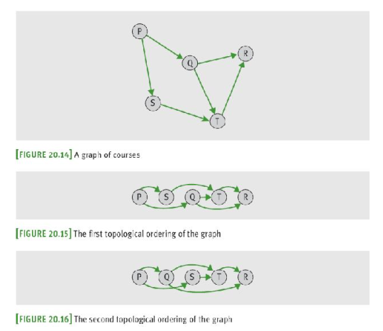
Topological Sort Example

Slide 35
Developing Graph ADT
The implementation of the graph ADT shown here consists of the classes:
Graph
Vertex

Slide 36
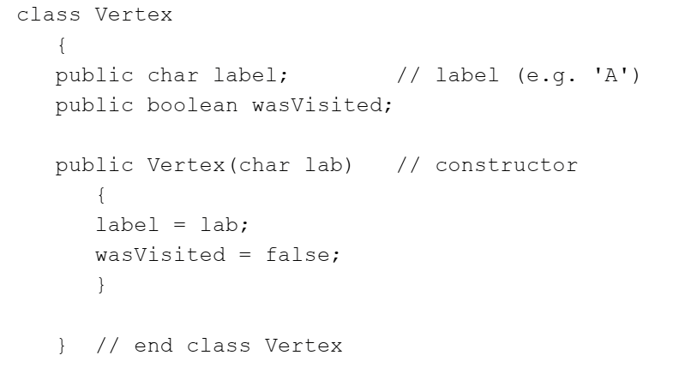
Vertex Class

Slide 37
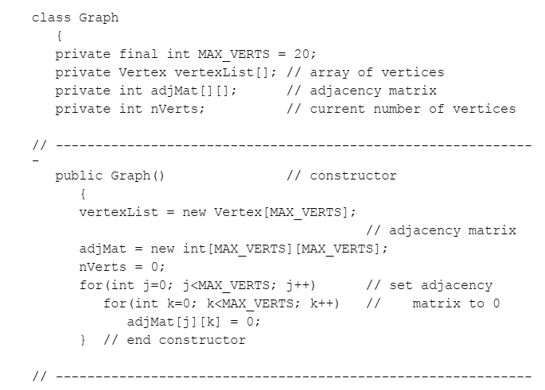
Graph Class

Slide 38
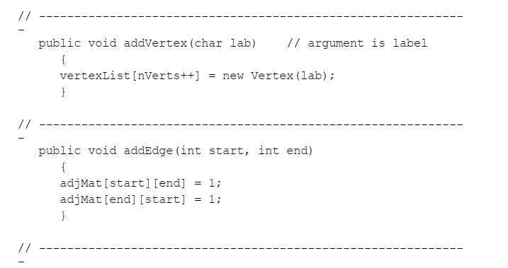
Graph Class

Slide 39
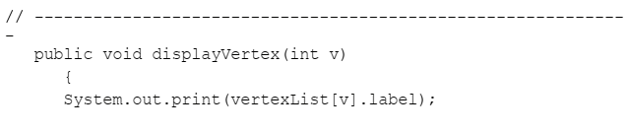
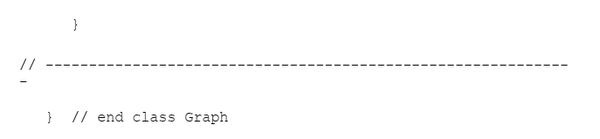
Graph Class

Slide 40
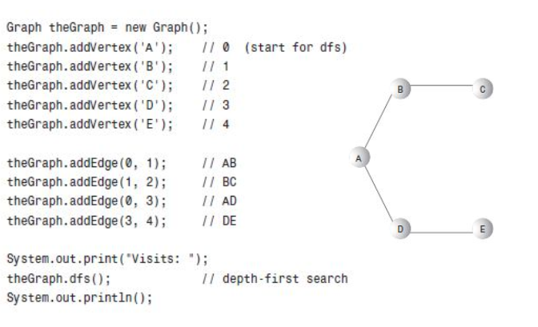
Example: Graph Creation

Slide 41
Summary
Graphs have many applications
A graph consists of one or more vertices (items) connected by one or more edges
Path: Sequence of edges that allows one vertex to be reached from another vertex in the graph
A graph is connected if there is a path from each vertex to every other vertex
A graph is complete if there is an edge from each vertex to every other vertex

Slide 42
Summary
A subgraph consists of a subset of a graph’s vertices and a subset of its edges
Connected component: a subgraph consisting of the set of vertices reachable from a given vertex
Directed graphs allow travel along an edge in just one direction
Edges can be labeled with weights, which indicate the cost of traveling along them
Graphs have two common implementations:
Adjacency matrix and adjacency list

Slide 43
Summary
Graph traversals explore tree-like structures within a graph, starting with a distinguished start vertex e.g., depth-first traversal/search and breadth-first traversal/search
A minimum spanning tree is a spanning tree whose edges contain the minimum weights possible
A topological sort generates a sequence of vertices in a directed acyclic graph

